Slide 1
Eating disorders in adolescents: Providing effective psychoeducation and concrete “How-Tos” for caregivers
Jessica M. Pierce, MD, MSc
Clinical Assistant Professor, Dept. of Psychiatry, Div. of Child & Adolescent Psychiatry
Pediatric Psychiatry Consultation-Liaison Service, C.S. Mott Children’s Hospital
April 2, 2022

Slide 2
Disclosures
I have no relevant disclosures

Slide 3
Learning Objectives
Understand how to assess for and diagnose eating disorders in adolescents
Explain the conceptual model of externalizing the eating disorder, recognizing both the benefits and the caveats to this approach
Articulate effective means of conveying the psychological frameworks around eating disorders to patients and families using metaphor and imagery
Impart helpful suggestions to caregivers regarding what to say and do to help their child in the treatment and recovery process

Slide 4
Assessment & Diagnosis
Brief Pearls

Slide 5
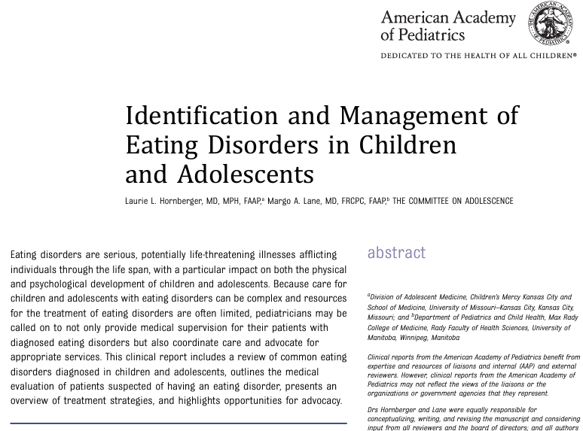

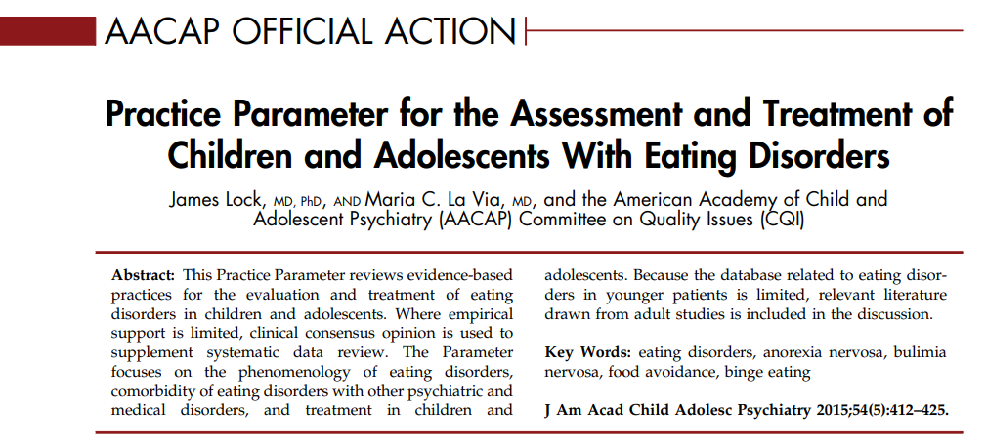

Slide 6
Online & Downloadable Tools
Screening:
SCOFF Questionnaire (BMJ 1999; 319:1467)
Eating Disorder Examination Questionnaire – Short (EDE-QS) (PLOS ONE May 2016)
Eating Attitude Test – EAT-26 (Psychol Med 1982)
Children’s Eating Disorder Attitude Test – ChEAT (Int J ED 1994)
Assessment:
Full clinical interview (for structured interview, full EDE helpful)
Follow AACAP Practice Parameters
Online via NEDA (NEDA screen)

Slide 7
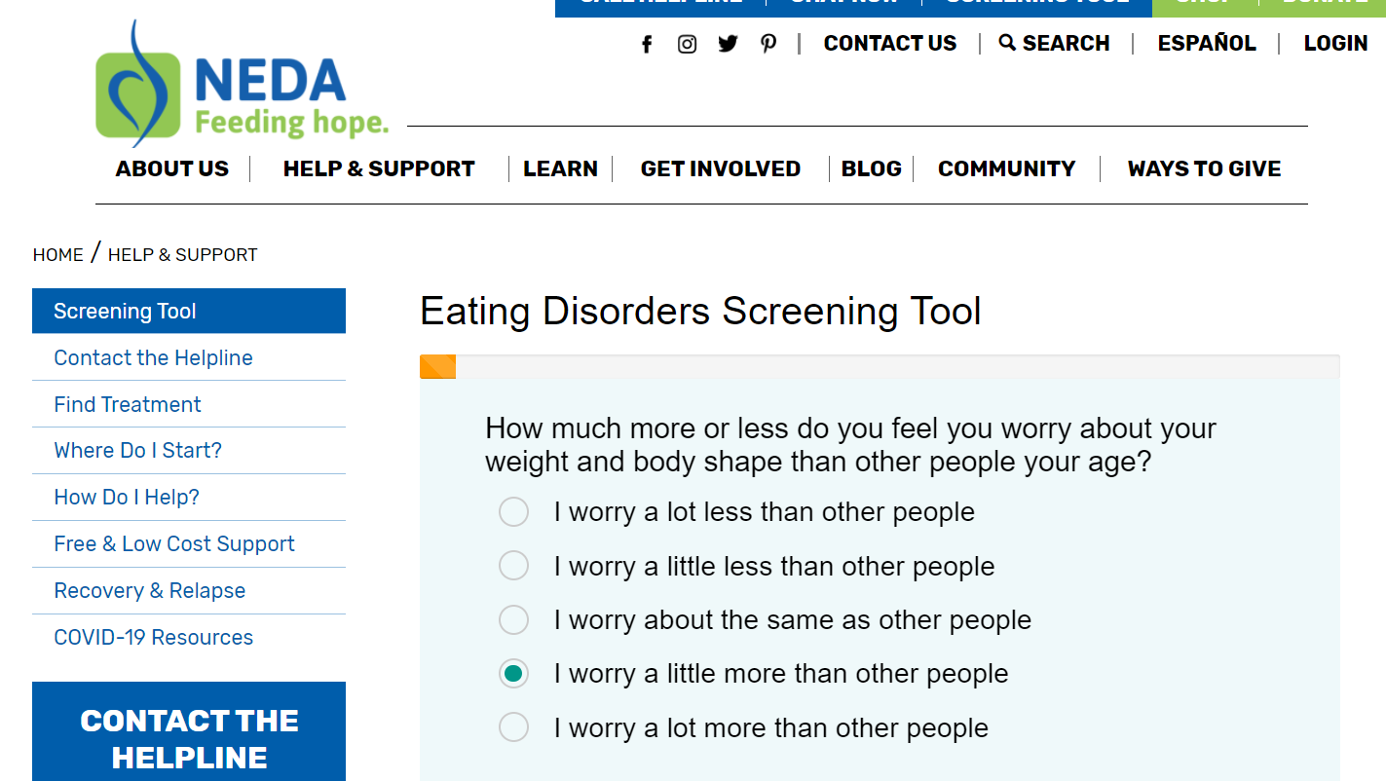

Slide 8
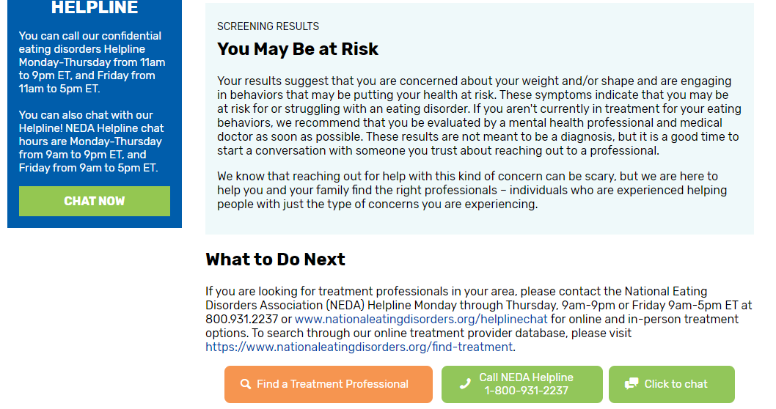

Slide 9
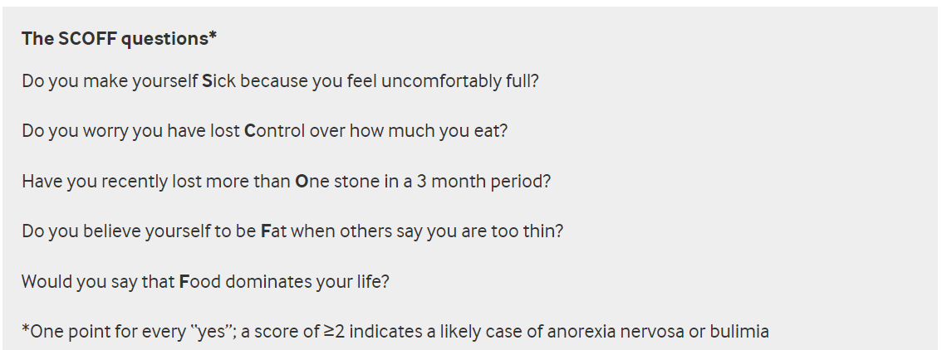

Slide 10
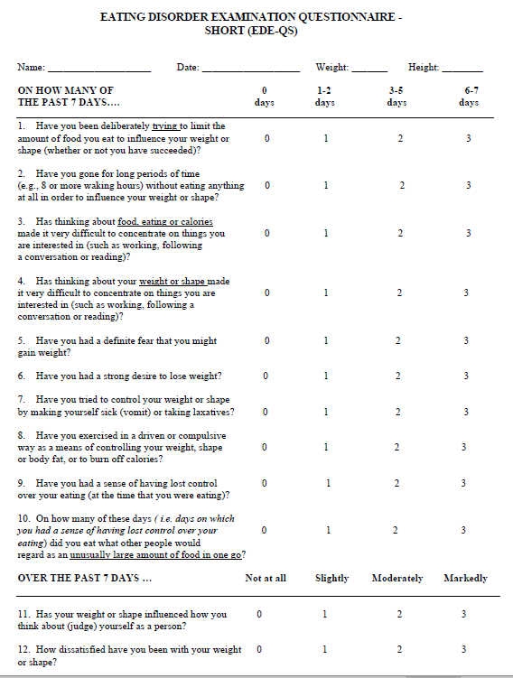
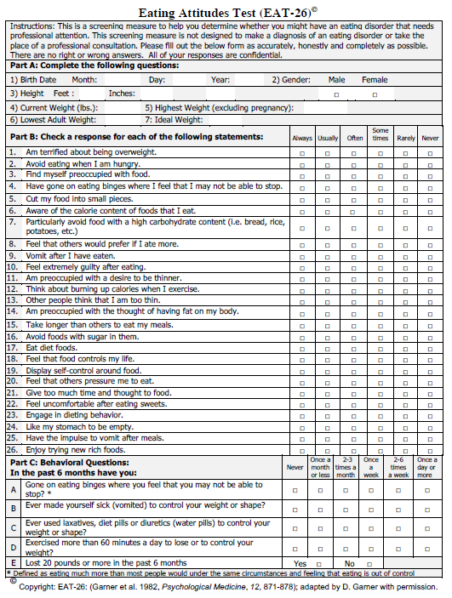

Slide 11

Look beyond…
Don’t miss:
Boys
“Healthy” weight or overweight teens
Pre-adolescents
Sexual minority youth
Youth of color
All socioeconomic brackets
Chronic medical illness (esp requiring dietary control)
Children with orthorexia (or families?)
Photos: dance.lovetoknow.com;
Photo: dance.lovetoknow.com

Slide 12

Unhealthy Numbers
42% of 1st-3rd grade girls want to be thinner
81% of 10-year-olds are afraid of being fat
46% of 9–11-year-olds are “sometimes” or “very often” on diets
35-57% of adolescent girls engage in crash dieting, fasting, self-induced vomiting, diet pills, or laxatives
91% of college-age women admit to controlling their weight through dieting
(anad.org)

Slide 13
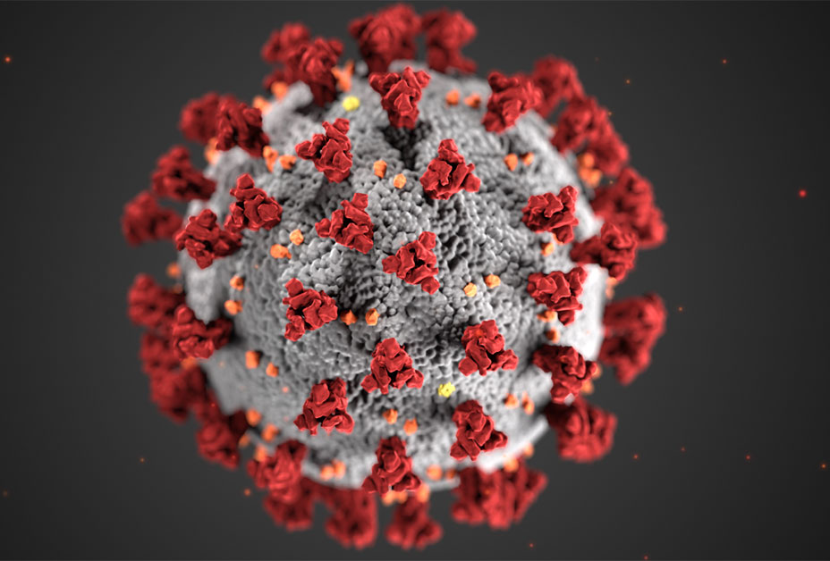
New Risk Factors
Social Isolation
Close-up on face (Zoom)
More sedentary activities
Disrupted routines
↑ Stress, Depression, Anxiety
Food insecurity?
Less access to healthcare

Slide 14
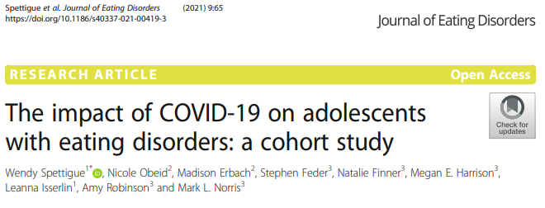
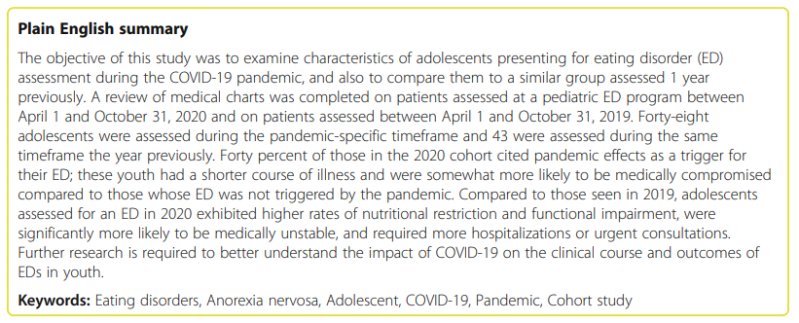

Slide 15
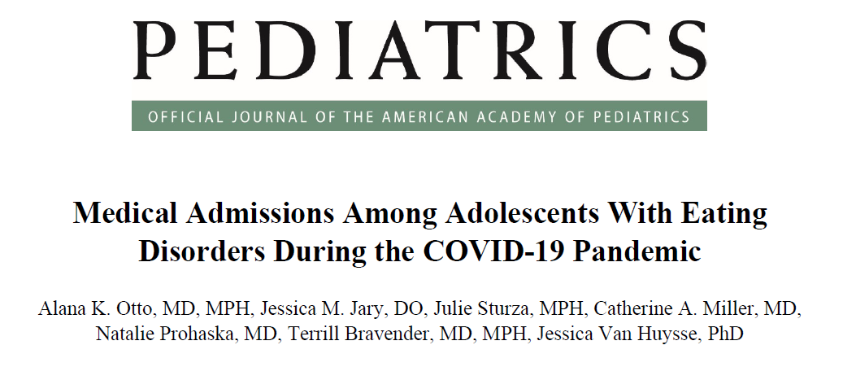
Pediatrics. 2021 Oct;148(4):e2021052201.

Slide 16
Treatment Planning
Brief Pearls

Slide 17
Co-Diagnose,
Co-Manage
Eating disorders are psychiatric and medical conditions
Ensure quick follow-up with PCP
Measure vitals and weight/height (BMI) and run basic labs if able (CBC, CMP, Mag, Phos, EKG). Monitor growth chart and weight change.
Even some “normal” weight children are severely malnourished and may require immediate medical hospitalization
If complete food refusal x 24 hrs, refer to the medical ED

Slide 18
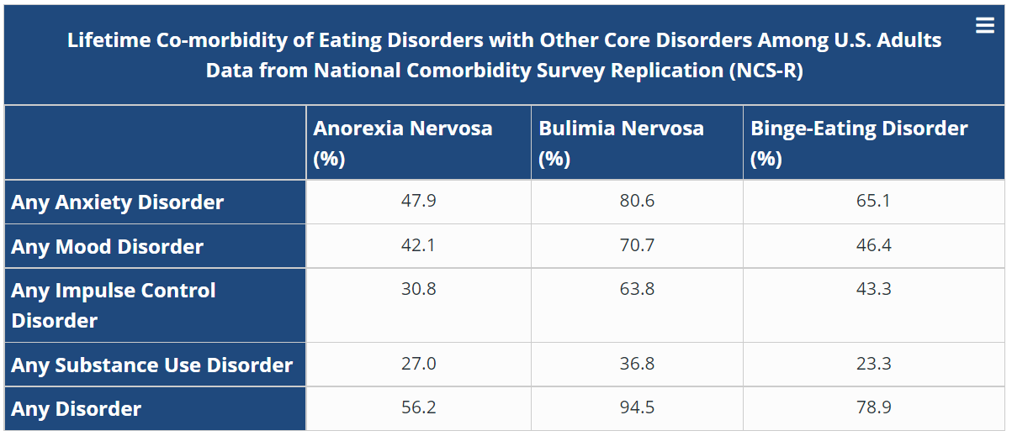
Manage Co-morbidities
(NIMH)

Slide 19
Level of Care?
Outpatient management
Therapist – w/ experience (or comfort) with eating disorders? FBT?
Psychiatrist – Meds? Comorbidities?
PCP or adolescent medicine specialist
Partial Hospitalization Program (PHP)/Intensive Outpatient Program (IOP)
CBT vs FBT focus?
In network?
Inpatient Psychiatric Admission
Sometimes hard to get covered if no SI
Residential Treatment
Insurance barriers
May be out of state

Slide 20
Psychiatric medications
Evidence for use of SSRIs in bulimia (high dose fluoxetine)
Limited evidence for effectiveness of SSRIs in anorexia, BUT:
  Treating co-morbid conditions may be very helpful!
Hydroxyzine
  Before meals, TID PRN or scheduled
  12.5 mg – 50 mg depending on weight and response
Olanzapine or Aripiprazole (next slides)

Slide 21
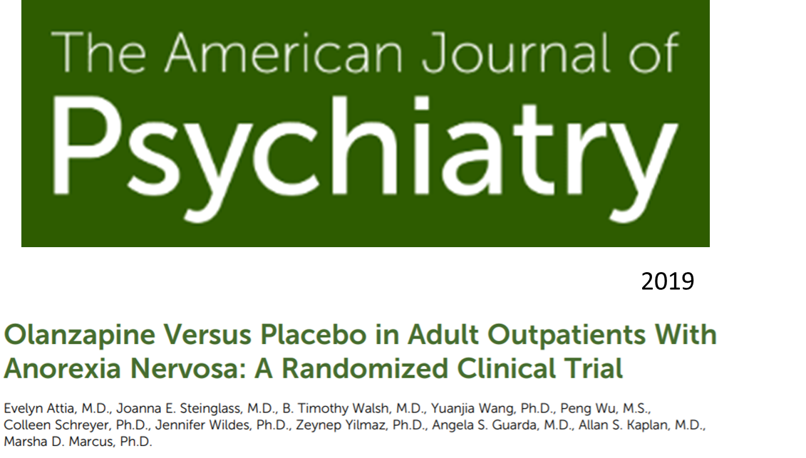
152 adult outpatients with anorexia nervosa:
Olanzapine 5–10 mg/day (mean = 6.2 mg/day) or
Placebo
16 weeks
Modest therapeutic effect of olanzapine on BMI, but not on psychological symptoms
Not associated with cardiometabolic adverse effects on lipid and glucose metabolism

Slide 22
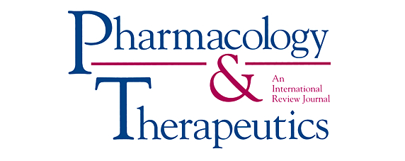
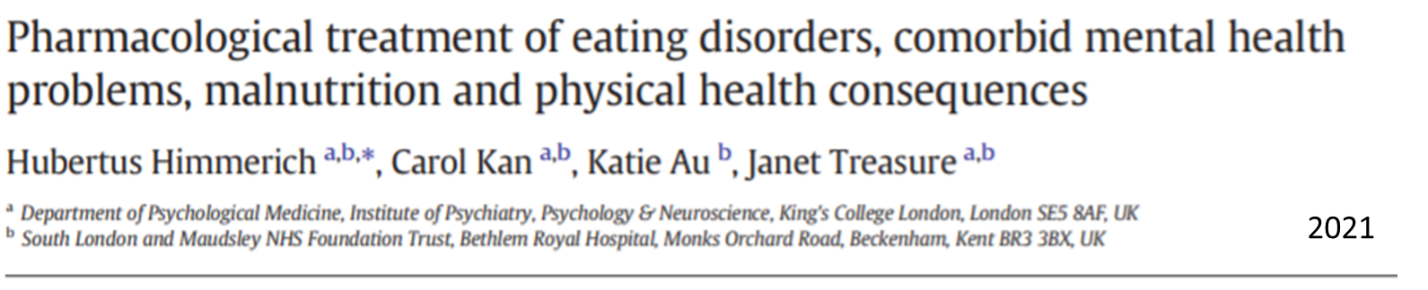
Small doses of olanzapine benefit:
Weight gain
Anxiety and sleep
Panic at mealtime
GI discomfort
Recommend avoiding in BN and BED given possibility of binging relating to appetite stimulation

Slide 23
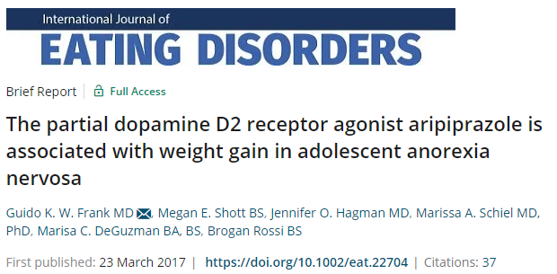
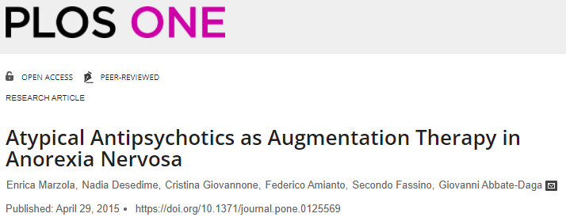
Aripiprazole
Improves weight gain
Reduces eating-related preoccupations and rituals with a large effect size

Slide 24
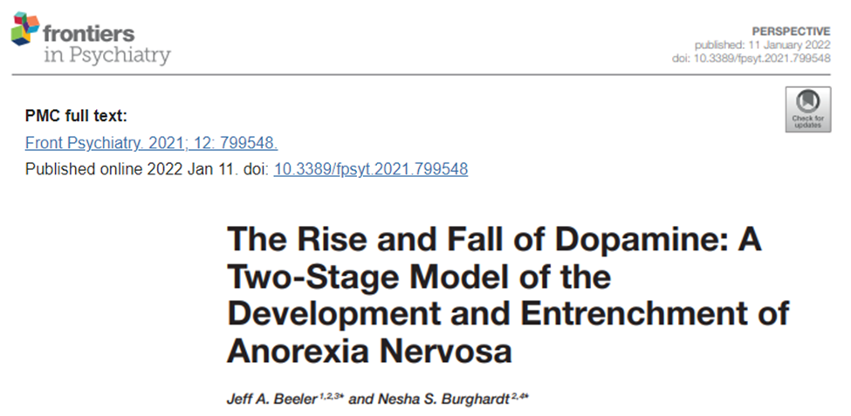
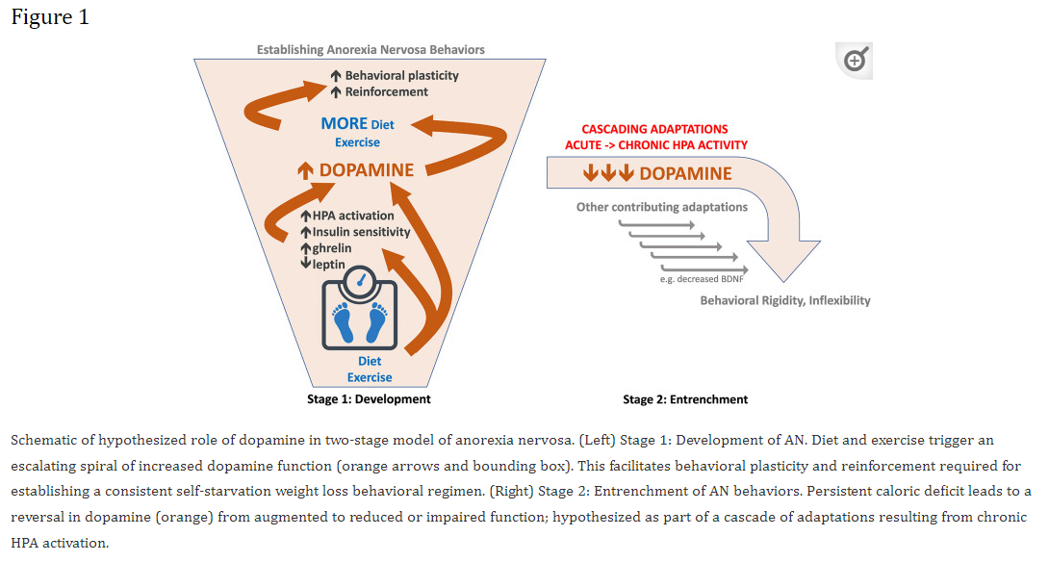
New Directions?

Slide 25
Capacity Assessments
Remember that eating disorders are psychiatric illnesses
Malnutrition significantly affects reason, logic, impulse control
May need to encourage parents to pursue medical guardianship of young adults

Slide 26
Psychoeducation
Conceptual Models & Metaphor

Slide 27
The Big Three
Anorexia Nervosa (AN)
Bulimia Nervosa (BN)
Binge Eating Disorder (BED)
Distorted thoughts about food and eating
Distorted thoughts about one’s body
Problematic behaviors around eating, exercise, weight loss

Slide 28

Understanding Perceptual Distortion
Photo: goodtherapy.org

Slide 29
Sound Bites for Parents
“Eating disorders completely change your child’s ability to see themselves accurately”
“Your child may feel, and wholeheartedly believe, they are fat or grotesque, even when their weight is dangerously low”
“These misperceptions typically only apply inward”
“Your child may recognize that others of normal weight around them appear healthy, but they are unable to view themselves that way”
It is very hard for family and friends to understand these ideas because the perception is not based in reality

Slide 30

Why is this happening?
Conceptual Model
Photo credit: Hellomagazine.com

Slide 31
Try not to focus on the “cause”
“Bullies at school...”
“It started with a diet...”
“Health class at school...”
“Grandma always comments on her weight...”
“The coach is too focused on being fit...”

Slide 32




“A lot of things contribute to the development of an eating disorder.”
“Understanding the cause is less important than moving forward with an intervention.”
Genetic Factors
Psychological Factors
Sociocultural Factors
Photo credits: freepikpsd; clipartlibrary; restaurantnews.com; People.com

Slide 33
“This is happening because an eating disorder has taken over the controls in your child’s brain.”
Externalizing the Eating Disorder

Slide 34


“The eating disorder is like a hijacker that has invaded your child’s brain.”
Photo credits: DisneyPixar Inside Out; shutterstock.com

Slide 35
Why Externalize the Eating Disorder?
Reframes the problematic behaviors
  Example: The child doesn’t choose to hide food or lie about what they have eaten; the eating disorder compels them to do those things
Puts everyone—the patient, family, and the providers—on the same team fighting against the eating disorder.
Allows family to aim the frustration or anger that they sometimes feel about their child’s behaviors at the eating disorder
Parents can then preserve a sense of empathy for their child as the victim of the illness
Patients are prone to feeling guilty; externalizing helps to alleviate their self-blame

Slide 36
“The person is not the problem.
The problem is the problem.”
Externalizing the Eating Disorder
Quote credit Lauren Muhlheim, PsyD, CED – see references

Slide 37





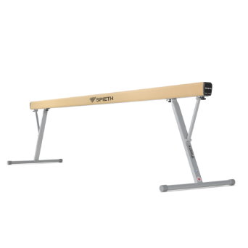

Externalizing the eating disorder also allows us to externalize the concepts of power and control.
Eating disorders often affect people who are high achievers normally.
They are used to feeling in control of their choices and are typically very skilled at handling that control.
They manage time well, self-regulate emotion, follow the rules, stick to plans, and maintain regular routines
These personal qualities can be very helpful when directed down the right channels:
Image credits: clipart-library; bestclipart.com; spiethgymnastics; fox

Slide 38
For people struggling with eating disorders, these personal strengths become liabilities.
The eating disorder sets up its own rules about:
  What, when, and how much to eat
  How often to exercise
  When to throw up or use laxatives
  What to say or how to behave when someone else challenges them about any of these things
“Over time, your child effectively becomes a straight-A student in the subject of malnutrition.”
“As a rule-follower, your child complies with the eating disorder’s rules.”

Slide 39




The child is caught between two competing goals and rule sets: what they want for themselves and what the eating disorder wants for them.
“Don’t eat that.”
“You’re fat and disgusting.”
“You don’t deserve that.”
“Hunger means it’s working.”
“Get rid of those calories.”
“Exercise until you feel faint.”
vs

Slide 40

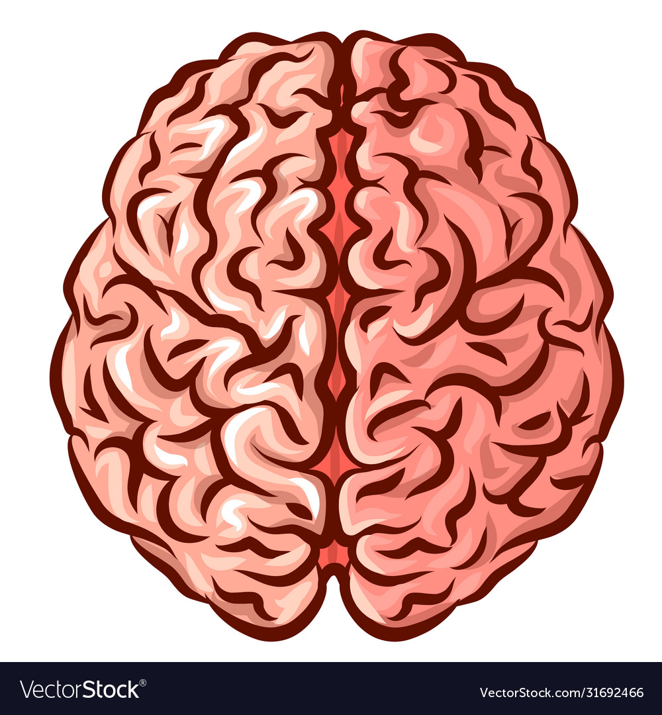
Destructive back-and-forth
It’s hard to focus on schoolwork when your mind is consumed with calorie counting → academic decline
It’s hard to hang out with friends when you’re always worried about how you look or what you’ll say if your friends want to go out to eat → social isolation
It’s hard to be honest with your parents when they’re constantly asking about how much you’ve eaten and you don’t want to let them down → family conflict
Photo credits: VectorStock; Shutterstock;

Slide 41
“The battle for control is physically exhausting and emotionally taxing, especially when operating with a malnourished brain and body.”
Externalizing the Eating Disorder

Slide 42
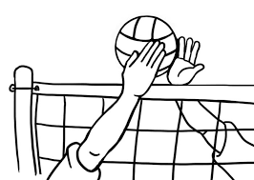
Volleyball Metaphor
Your child vs eating disorder
Ball represents power and control over:
  Food choices
  Meal quantities
  Exercise
  Purging
  Truth-telling
Treatment:
  Remove the “control” ball from the court entirely
Image credits: clipart library

Slide 43

Referee
In the hospital:
Providers
Nurses
Dietitians
Patient Attendants (1:1)
With the control ball out of play, the referee:
Chooses the food
Prepares the food
Plates the food (determines portion)
Sets the meal schedule
Prevents overexertion
Monitors for body’s response to treatment
In the community:
Parents
Teacher/School Nurse
Outpatient Team

Slide 44
“The eating disorder can’t steal control if there isn’t any control up for grabs.”
Externalizing the Eating Disorder

Slide 45


Family-Based Treatment
Caregiver controls all aspects in early phase
Gradually return control over food, eating, and activity to the adolescent during recovery
Ultimate goal is to re-establish a typical relationship with food
Photo credits: thrivehere.com; preparedfoods.com

Slide 46
A caveat to externalization: some patients really hate it
“It makes me feel dismissed. It invalidates my personal experience.”
“Even the negative thoughts are my own. I need to own them to move on.”
“These thoughts are part of me...my identity.”
“When people attribute everything to the eating disorder, it makes me feel invisible.”
Parent: “Makes them seems helpless. I want them to have some responsibility for their recovery.”

Slide 47
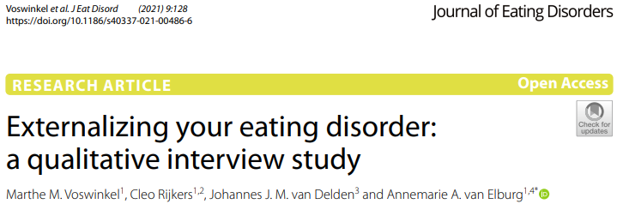

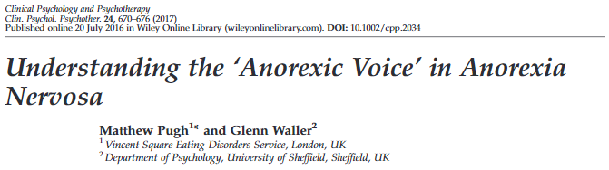
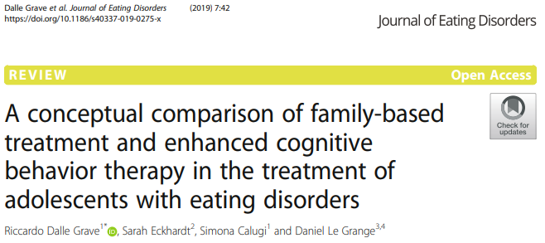
Image credit: istock.com

Slide 48
“Find the approach that fits your family.”
Conceptual Model & Treatment Approach

Slide 49

Regardless of conceptual model, families must recognize and understand the important role of fear.
Gaining weight!
Losing myself!
Losing control!
Looking gross!
Giving in!
Fatty foods!
Being weak!
Getting ostracized!
Carbs!
Being inactive!
Dying!
Feeling sick!
Letting everyone down!
Image credit: DisneyPixar

Slide 50


Fear trumps logic and reason.
Fear buddies up with anger.
Malnutrition
No access to higher-order brain function
Rigid, inflexible, and stuck
Image credit: DisneyPixar; Smithsonianmagazine

Slide 51
How-To Info
What to say and do

Slide 52
Challenging Perceptual Distortion
Photo: goodtherapy.org

Slide 53
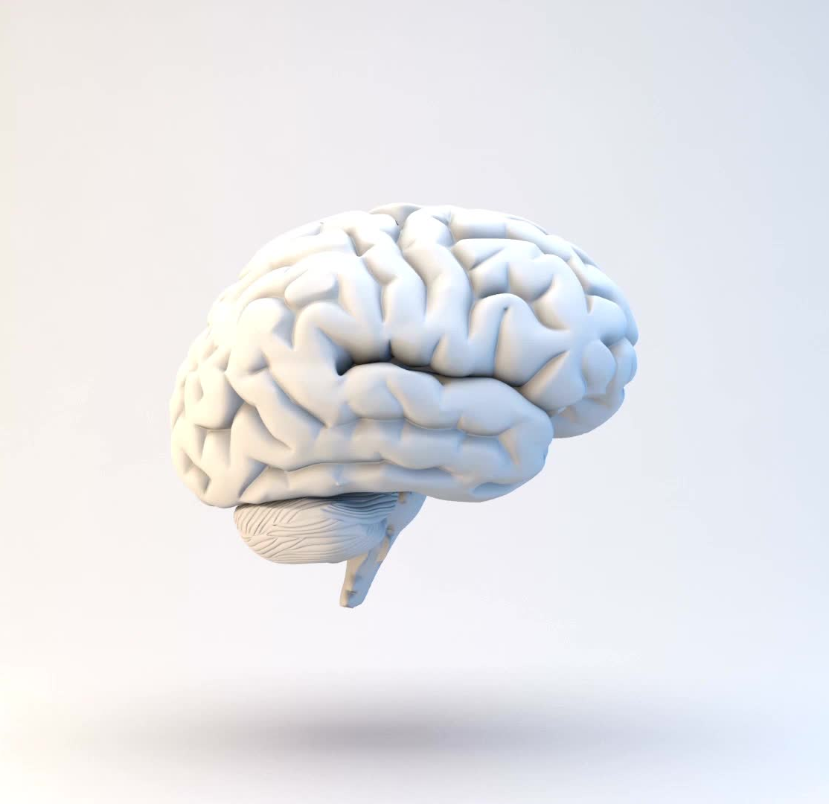
Challenging Perceptual Distortion
Remember, the child’s thoughts are not based in reality. Simply telling the child they are not fat is ineffective
Child has little access to logic, reason, and emotion regulation when fearful and malnourished.
The brain defaults to rigid thinking.
Attempts to rationalize are often met with extreme anger and fear.
This may prompt your child to say or do things that would otherwise be out of character for them.

Slide 54
“The single best treatment for your child’s distorted thoughts and perceptions is to restore their nutrition.”
When severely malnourished...
Food is medicine.

Slide 55
Ongoing work with a skilled therapist and/or team within the chosen treatment model
When medically stabilized and during weight restoration...

Slide 56
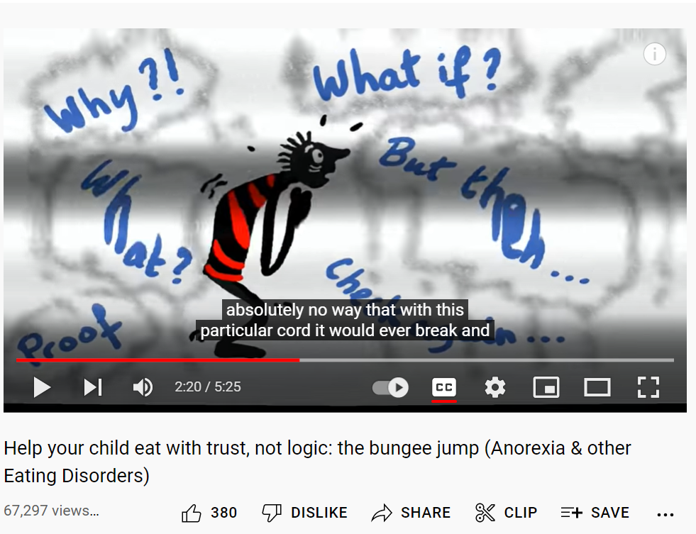
Trust, Not Logic
Eva Musby Bungee Jump Video Link

Slide 57
If you hear...
“This is way too much food.”
“This is really unhealthy food and it would be bad for anyone.”
Validate your child’s distress, and then confidently reinforce the plan
“I’m too full. I can’t eat anymore.”
“I wouldn’t have eaten this even before the eating disorder.”
“This is going to make me so fat.”
“This is like torture.”

Slide 58
Vague statements that don’t invite further discussion are very useful:
“I’m sorry you’re feeling this way. This is very hard.”
Note: Try to avoid saying “I know this is hard,” because you may be met with a response about how you don’t know what this is like.
“It seems like the eating disorder is really strong right now. Let’s focus on ______ (activity).”
“Let’s trust the experts, they know what your body needs.”
“Please keep going.”
“Take another bite of ______.”

Slide 59


The Dangers of Negotiation
The eating disorder is constantly looking for ways to regain control of the situation
Negotiation—food choice, amount, schedule—signals to the eating disorder that the refeeding process is flexible, and, by extension, interruptible
Stick to the plan.
Image credit: shutterstock

Slide 60

The (Possible) Problem with Praise
“You’re doing great!”
“You’re being weak!”
Guilt and Remorse
Image credit: healthcare news

Slide 61
Use Gratitude Instead
“That wasn’t easy. Thank you for finishing that meal.”
Every child is different
If praise would be helpful/motivating, do it!
Talk with the child from the beginning:
“Would it be helpful for you if I tell you that you’re doing a good job? Or is there something else that would be more helpful for me to say?”
Taking the cue from your child about these sorts of things is doing the opposite of negotiating with the eating disorder; it’s empowering your child.

Slide 62
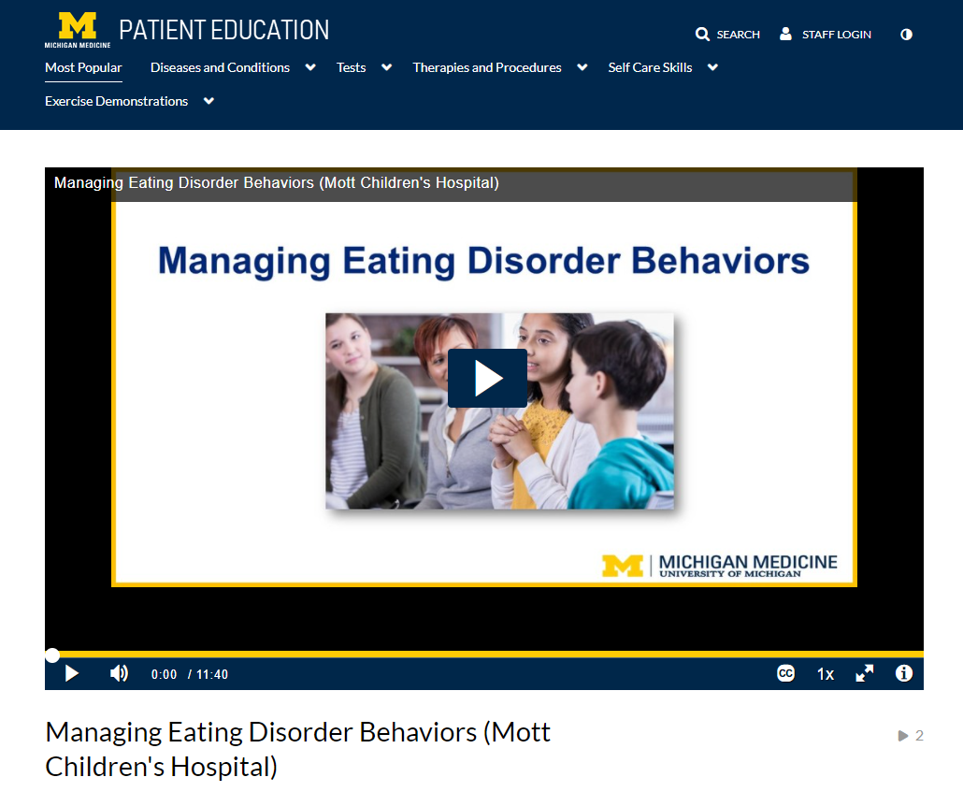

Educational video for caregivers
https://michmed.org/vVgJz

Slide 63
Supports
Groups, Websites, Books, Peers

Slide 64

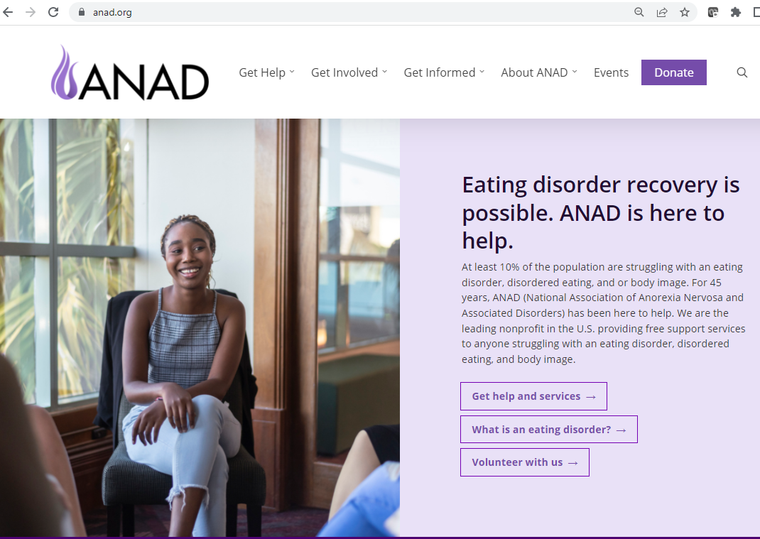
The National Association of Anorexia Nervosa and Associated Disorders, Inc. (ANAD): http://www.anad.org/
National Eating Disorder Association (NEDA):
https://www.nationaleatingdisorders.org/

Slide 65


Maudsley Parents: http://www.maudsleyparents.org
Families Empowered and Supporting Treatment of Eating Disorders (F.E.A.S.T):
www.feast-ed.org

Slide 66
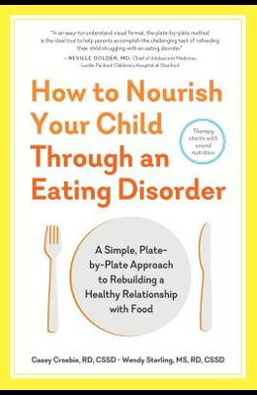
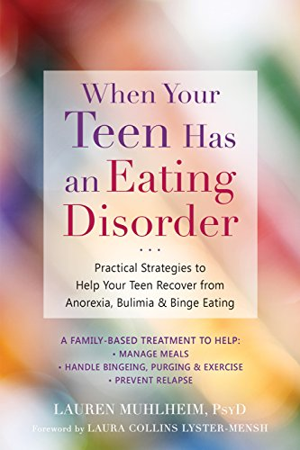
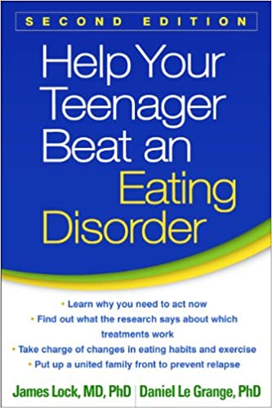

Slide 67

Questions/Discussion
Photo: photographylife.com

Slide 68
References
Hornberger LL, Lane MA; COMMITTEE ON ADOLESCENCE. Identification and Management of Eating Disorders in Children and Adolescents. Pediatrics. 2021 Jan;147(1):e2020040279.
Lock J, La Via MC; American Academy of Child and Adolescent Psychiatry (AACAP) Committee on Quality Issues (CQI). Practice parameter for the assessment and treatment of children and adolescents with eating disorders. J Am Acad Child Adolesc Psychiatry. 2015 May;54(5):412-25.
Garner DM, Olmsted M, Bohr Y, Garfinkel P. The Eating Attitudes Test: psychometric features and clinical correlates. Psychol Med. 1982;12: 871-878.
Molak L, Levine MP. Psychometric properties of the Children's Eating Attitudes Test. Int J Eat Disord. 1994 Nov;16(3):275-82.
Spettigue W, Obeid N, Erbach M, Feder S, Finner N, Harrison ME, Isserlin L, Robinson A, Norris ML. The impact of COVID-19 on adolescents with eating disorders: a cohort study. J Eat Disord. 2021 Jun 4;9(1):65.
Otto AK, Jary JM, Sturza J, Miller CA, Prohaska N, Bravender T, Van Huysse J. Medical Admissions Among Adolescents With Eating Disorders During the COVID-19 Pandemic. Pediatrics. 2021 Oct;148(4):e2021052201.
Attia E, Steinglass JE, Walsh BT, Wang Y, Wu P, Schreyer C, Wildes J, Yilmaz Z, Guarda AS, Kaplan AS, Marcus MD. Olanzapine Versus Placebo in Adult Outpatients With Anorexia Nervosa: A Randomized Clinical Trial. Am J Psychiatry. 2019 Jun 1;176(6):449-456.
Himmerich H, Kan C, Au K, Treasure J. Pharmacological treatment of eating disorders, comorbid mental health problems, malnutrition and physical health consequences. Pharmacol Ther. 2021 Jan;217:107667.
Beeler JA, Burghardt NS. The Rise and Fall of Dopamine: A Two-Stage Model of the Development and Entrenchment of Anorexia Nervosa. Front Psychiatry. 2022 Jan 11;12:799548.

Slide 69
References
Frank GK, Shott ME, Hagman JO, Schiel MA, DeGuzman MC, Rossi B. The partial dopamine D2 receptor agonist aripiprazole is associated with weight gain in adolescent anorexia nervosa. Int J Eat Disord. 2017 Apr;50(4):447-450.
Lauren Muhlheim, PsyD, CED. “Externalizing an Eating Disorder: When, Why, and How Do You Do That and Who is “Ed” Anyway?” From Eating Disorders Therapy LA, 8/29/2021. Access: https://www.eatingdisordertherapyla.com/externalizing-an-eating-disorder/
Dalle Grave R, Eckhardt S, Calugi S, Le Grange D. A conceptual comparison of family-based treatment and enhanced cognitive behavior therapy in the treatment of adolescents with eating disorders. J Eat Disord. 2019 Dec 31;7:42.
Voswinkel MM, Rijkers C, van Delden JJM, van Elburg AA. Externalizing your eating disorder: a qualitative interview study. J Eat Disord. 2021 Oct 15;9(1):128.
Pugh M, Waller G. Understanding the 'Anorexic Voice' in Anorexia Nervosa. Clin Psychol Psychother. 2017 May;24(3):670-676.

